Slide 1
Drone delivery system unit
Day 6
Standards:
8.PS2.3
8PS2.4
8.PS2.5

Slide 2


DQ
Newton’s 2nd Law of Motion states that force is equal to the mass times the acceleration.
If the force acting on the object stays the same but the mass increases, what is most likely to happen to the acceleration of the object?
a. Velocity will change but the speed and direction will remain constant.
b. Velocity will not change but the speed and direction will remain constant.
c. Acceleration will increase
d. Acceleration will decrease
Standards: 8.PS2.3, 8PS2.4, 8.PS2.5

Slide 3
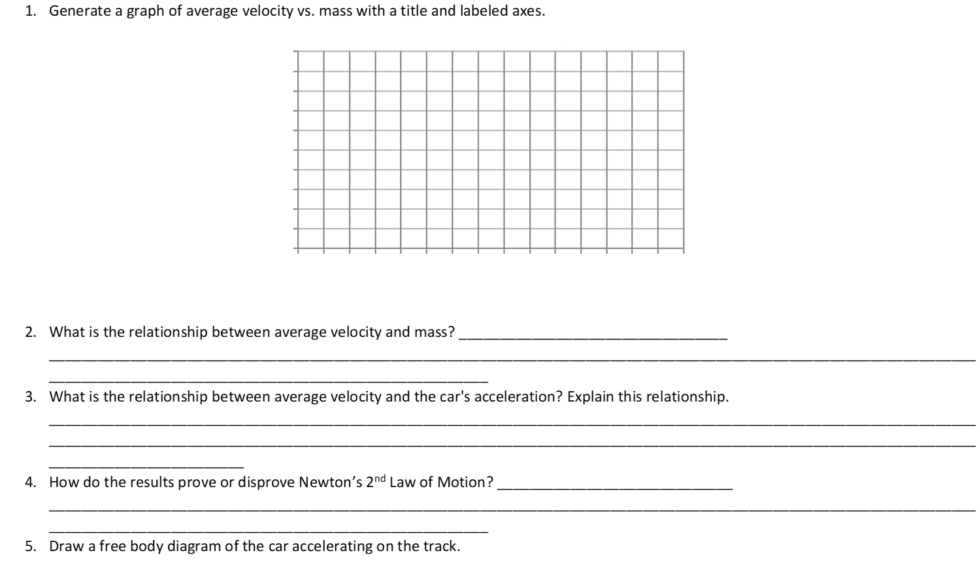
Check answers
Vectors – objects which have both magnitude and direction.
Standards: 8.PS2.3, 8PS2.4, 8.PS2.5

Slide 4
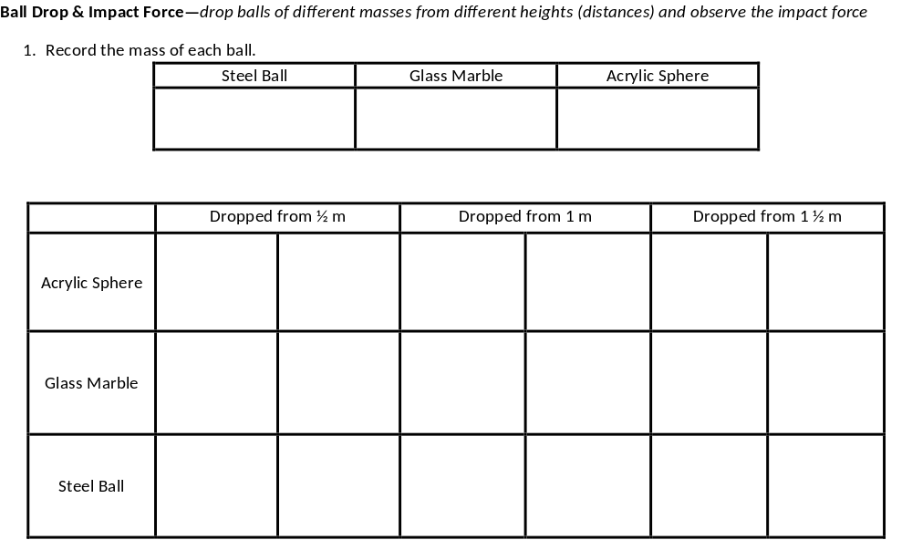
Free Fall – In a free fall, objects of different masses all fall at the same rate or acceleration- 9.8m/s² (gravitational acceleration).
Today you will investigate this question and see how this might affect the delivery of the medical supplies during a monsoon.
Standards: 8.PS2.3, 8PS2.4, 8.PS2.5

Slide 5
3. Construct an explanation to describe if this an example of balanced or unbalanced force.
_________________________________________________________________________________________________________________________________________________________________________________________________________________________________________________________________________________________________________
4. Which mass had a greater impact force? Why?
_________________________________________________________________________________________________________________________________________________________________________________________________________________________________________________________________________________________________________
5. How did the distance from which the ball was dropped affect the impact force?
_________________________________________________________________________________________________________________________________________________________________________________________________________________________________________________________________________________________________________
6. Draw a free-body diagram to show the forces acting on the ball and explain the cause and effect relationship between mass and distance and how they affect impact force. How do mass
and distance affect gravity?
_______________________________________________________
_______________________________________________________
_______________________________________________________
_______________________________________________________
_______________________________________________________
_______________________________________________________
___________________________________________________
Standards: 8.PS2.3, 8PS2.4, 8.PS2.5

Slide 6
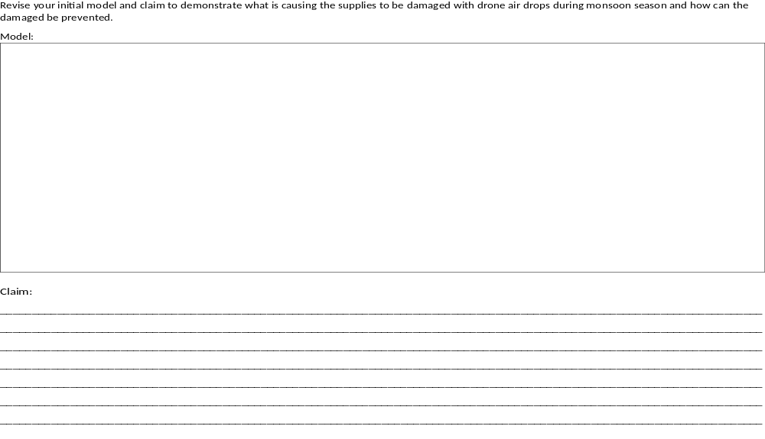
Standards: 8.PS2.3, 8PS2.4, 8.PS2.5

Slide 7
Exit Ticket:
What is Newton’s 2nd Law of Motion?

